Slide 1

CS361 MACHINE LEARNING PROJECT PRESENTATION
CREDIT RISK ASSESSMENT
GROUP:ML MARVELS

Slide 2
GROUP COMPOSITION
Bhogi Sai Sathwik 21010103O
Bussa Sai Santhosh 210101033
Himangshu Deka 210101050
Naladala Navadeep 210101072

Slide 3
WORK DISTRIBUTION
EDA AND PREPOCESSING:All(chiefly B Sai Santhosh)
Logistic Regression :Bhogi Sai Sathwik
GNB:Naladala Navadeep
SVM:Bussa Sai Santhosh
Decision Tree and remaining:Himangshu Deka

Slide 4
MOTIVATION BEHIND THE PROJECT
Project Objective: Develop machine learning-based models for credit risk analysis to predict loan statuses based on borrower and loan attributes.
Goal: Provide financial institutions with reliable tools for credit risk management, enhancing lending practices and promoting financial stability.
Motivation:
Importance of credit risk assessment in ensuring responsible lending practices.
Safeguarding financial institutions against potential defaults.
Significance in the Indian context, especially with initiatives like Jan Dhan Yojana promoting financial inclusion.
Contribution:
Advancement of responsible lending practices.
Support for financial inclusion initiatives and economic development.

Slide 5
PROBLEM DESCRIPTION
Objective: Develop machine learning models for a classification problem to predict whether the loan status of a loan applicant should be sanctioned or not.
Dataset: Contains 81 columns and approximately 113,000 data points, including important features like Borrower APR, Borrower Rate, Prosper Rating, Employment Status, Occupation, Prosper Score, etc.
The feature ‘Loan Status’ in this dataset is of particular interest to us,this column has values like ‘Completed’,’Defaulted’,’Past Due’,’Charged Off’ etc.as we would be converting our problem to a 2 class classification problem.
We woud be converting our problem to a two class classification problem with class -1 predicting implicitly safe lending for the lender and class-0 bearing the opposite.This decision is motivated by the nature of the values of the ‘Loan Status’ Feature.(expounded upon further in the EDA and Preprocessing section.)
Outline of the Project:
Exploratory Data Analysis (EDA)
Data Preprocessing
Principal Component Analysis (PCA)
Model Building and Evaluation:
Gaussian Naive Bayes
Logistic Regression
Support Vector Machine (SVM)
Decision Tree
Ensemble Methods
Model Evaluation for each technique used.

Slide 6
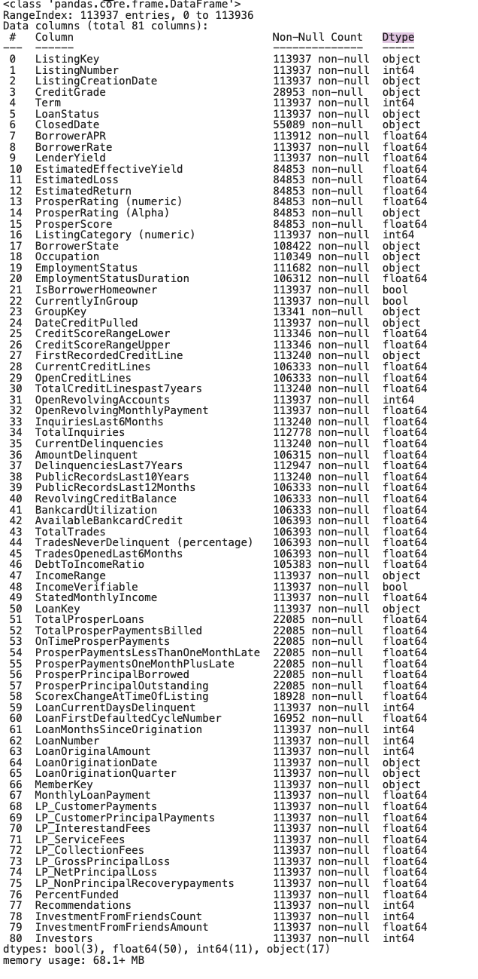
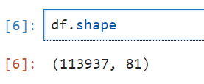
DATASET DESCRIPTION
We got the dataset from Kaggle:-
https://www.kaggle.com/code/suwarnabaraskar/prosperloan-patch-3suwarna/input
Size of the data set

Slide 7
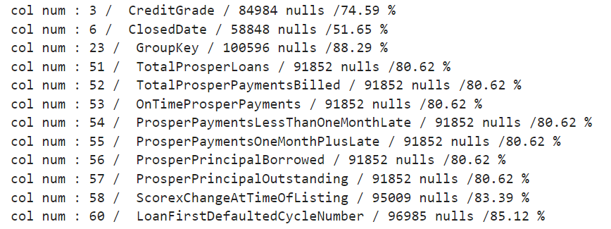

PREPROCESSING
HANDLING NULL VALUES
Calculated the percentage of null values in each column of the database.
Removed columns with null values exceeding 50%.
For numeric coulmns we replaced the null values with mean of the column and for non numeric columns we replaced them with mode

Slide 8
PREPROCESSING
Dropped the columns which are not important in the context of Loan Default Predection such as Listing Key, Date and time on which loan was sanctioned etc..
Designated the column "Loan Status" as the target column.
Removed rows in the database with null values in the "Loan Status" column.

Slide 9
EDA
Loan Status Distribution:
Most loan statuses are still current.
Borrowed Amount Distribution:
Majority of loans fall into the average amounts of $5,000, $10,000, and $15,000.
Loan Duration:
Most loans have a duration of three years, followed by five years.
Employment Status:
Majority of people are employed, but more than half do not own their own house.
Average Number of Accounts:
On average, a client is likely to have 6 accounts.
Average Monthly Disbursement:
Average monthly disbursement stands at around $1,000.
Reasons for Loans:
Most common reasons for loans include Debt Consolidation, Home, Business, and Others.

Slide 10
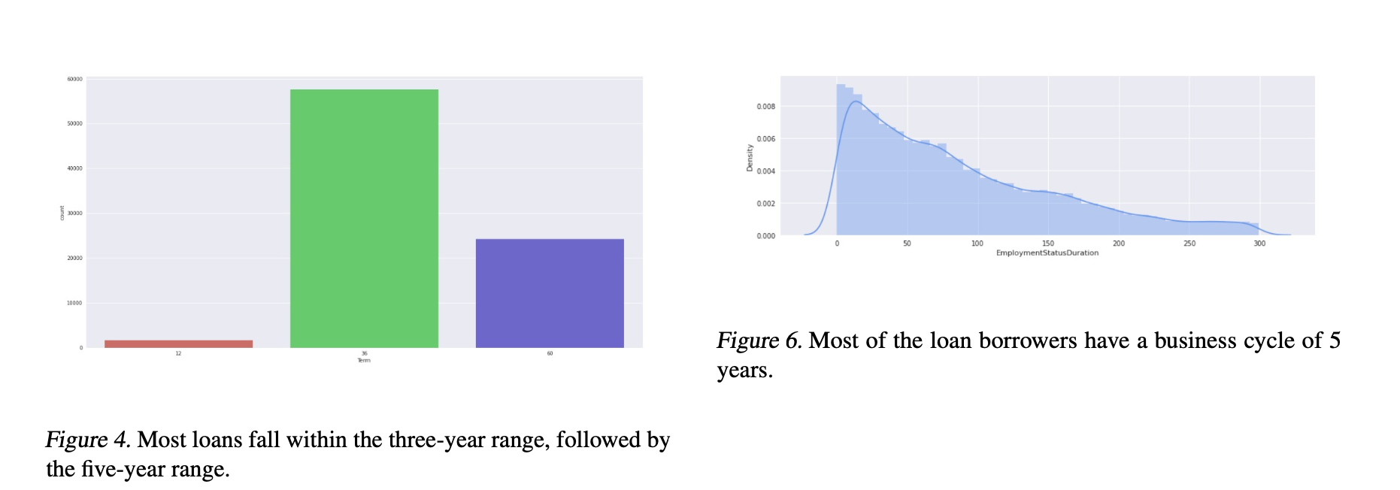
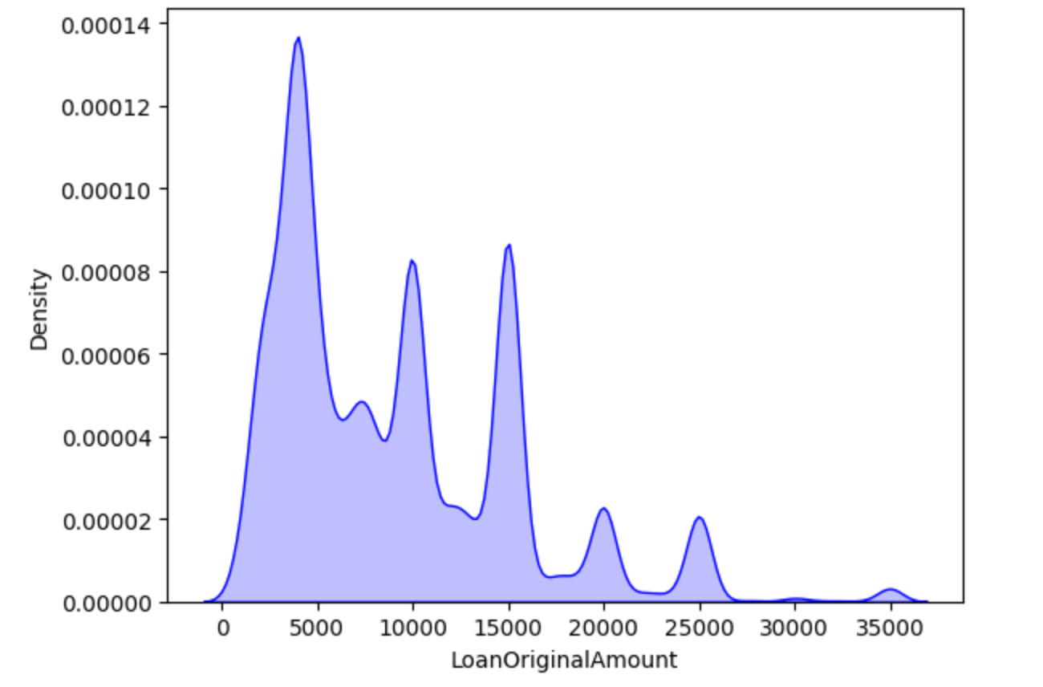

Slide 11
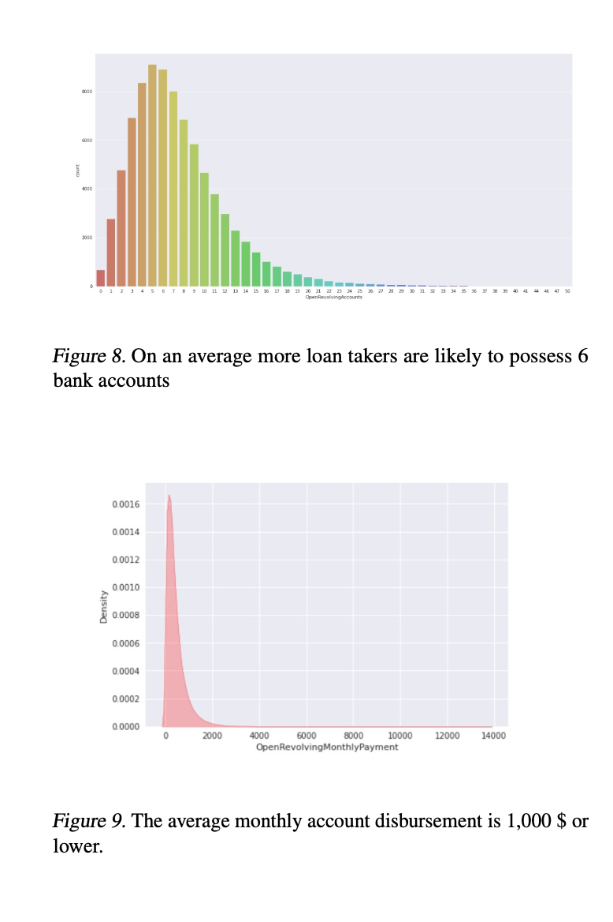
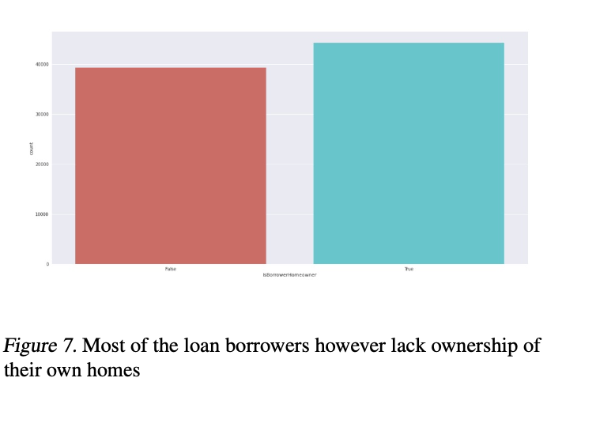

Slide 12
PREPROCESSING
Label Encoding:
Utilized Label Encoding for columns with labeled data, aiming to encode categorical columns. The "Loan Status" column was selected as the target variable.
One Hot Encoding:
Applied One Hot Encoding to categorize entries in the "Loan Status" column, considering it as a categorical variable. Only the "Completed" column was retained for the binary classification problem.
Train-Validation-Test Split:
Split the dataset into training, validation, and test sets, with both the validation set and test set size being 10% each. The "Loan Status" column was considered the target column, labeled as "Y," and split accordingly into Y train, Y val, and Y test.
Standardization:
Standardized both the training and test data to ensure they have a mean of 0 and a standard deviation of 1. This step is crucial for preparing the data for subsequent processing, enhancing model performance and stability. A function was employed to calculate the mean and standard deviation from the training data and applied the same transformation to both the training and test sets. This ensured consistency in data preprocessing across different datasets.

Slide 13
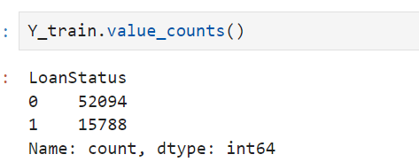
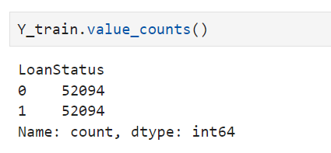
Balancing Data
Here we can observe that class 1 is a minority class we have only 15k entries for it where as for class 0 we have 52k entries so used synthethic minority oversampling Technique(SMOTE). As class 0 is under represented and it is important to perform well on it
SMOTE works by synthesizing new examples from the existing minority class samples which are close in feature space drawing a line between them and generating new instances along that line
Thus, we balanced the class distribution, this helps to solve the problem of bias towards the majority class that may occur while training the models
Before SMOTE
After SMOTE

Slide 14
PCA
Correlation Matrix Analysis:
Identified high correlation among many columns/features.
Principal Component Analysis (PCA):
Conducted PCA to reduce the dimensionality of the data and decrease the time required to run the models.
Set a threshold of 75% on explained variance ratio.
Selected 20 as the number of Principal Components based on the threshold set.
Purpose: PCA filters out noise and enhances signal-to-noise ratio in high-dimensional data, leading to better predictive modeling performance.
Benefits: PCA simplifies data, eliminates noise, and identifies variable patterns by capturing maximum variance directions.
Principal Component Selection: Choosing 21 out of 65 principal components balances information retention with effective dimensionality reduction.
High Variance Retention: Retaining 21 components preserves a substantial portion of the data's variance, ensuring important patterns are captured.
Computational Efficiency: This choice optimizes computational resources by balancing dimensionality reduction with manageable complexity for subsequent analyses.

Slide 15
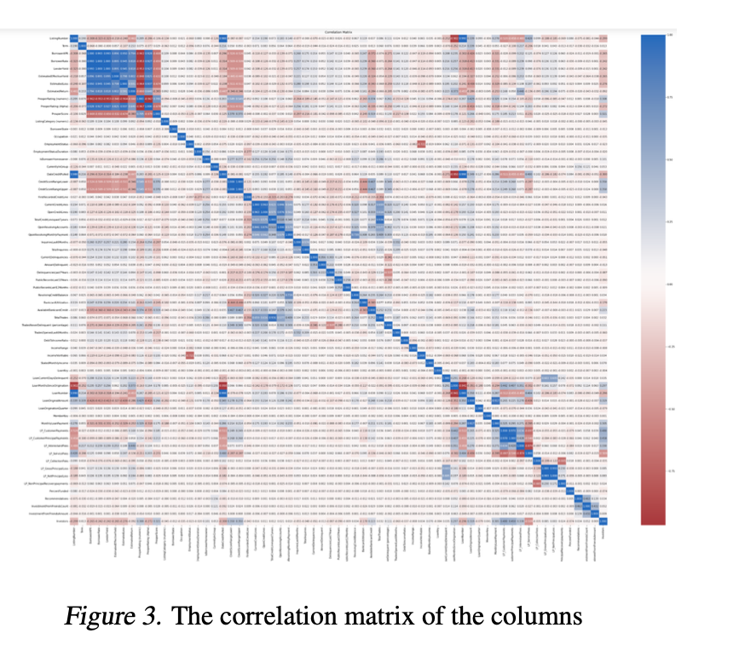

Slide 16
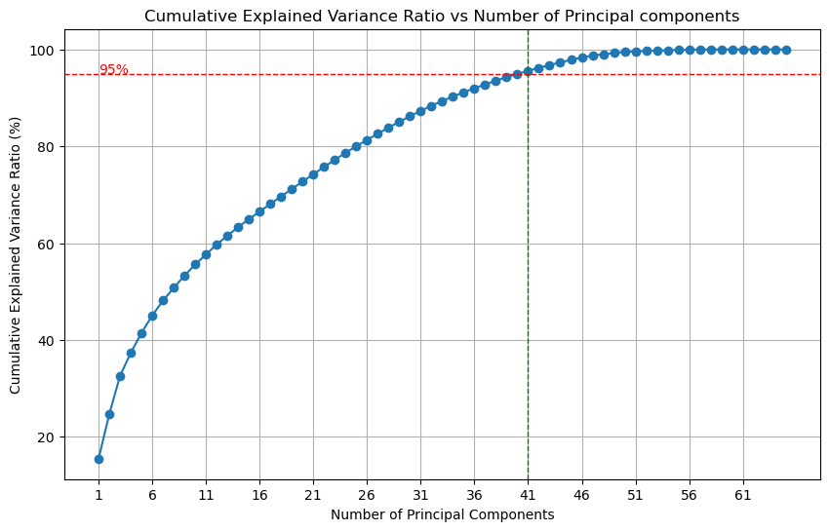

Slide 17
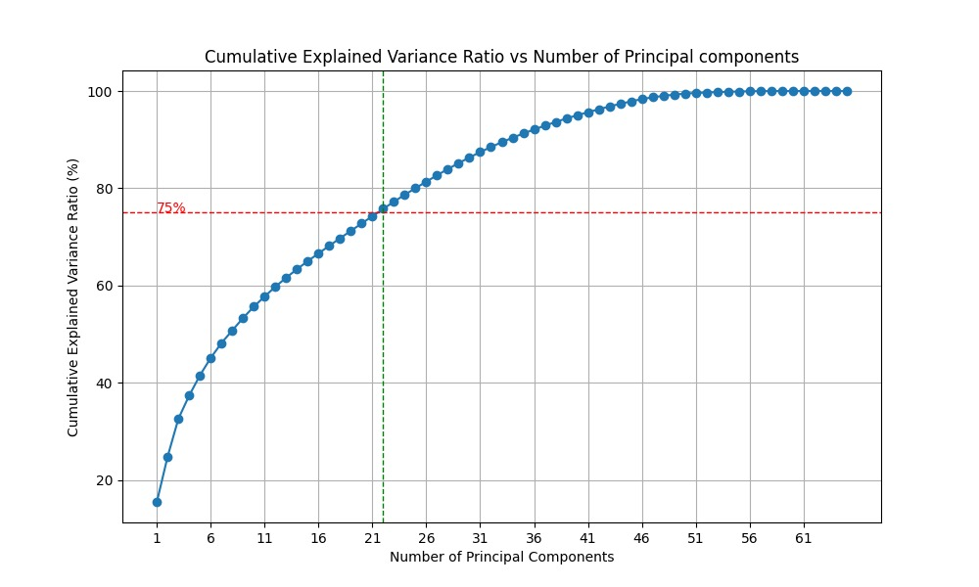

Slide 18
MACHINE LEARNING ALGORITHMS
OUTLINE
GAUSSIAN NAIVE BAYES
LOGISTIC REGRESSION
SUPPORT VECTOR MACHINE
DECISION TREE
RANDOM FOREST AND GRADIENT BOOSTING
We wish to run the first four models, perform hyperparameter tuning, and compare the metrics of these four with the results of the ensemble methods (done without hyperparameter tuning, using default hyperparameters in the sklearn inbuilt library).
METRICS USED:F1 Score

Slide 19
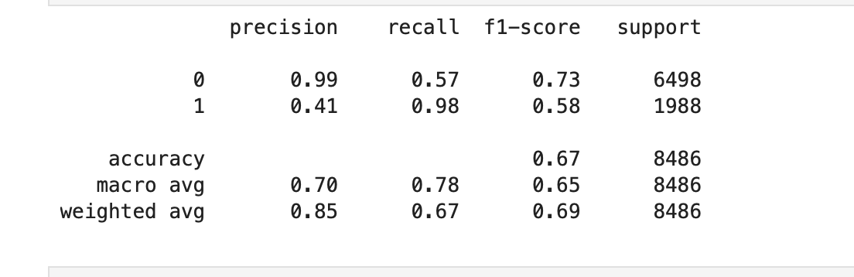
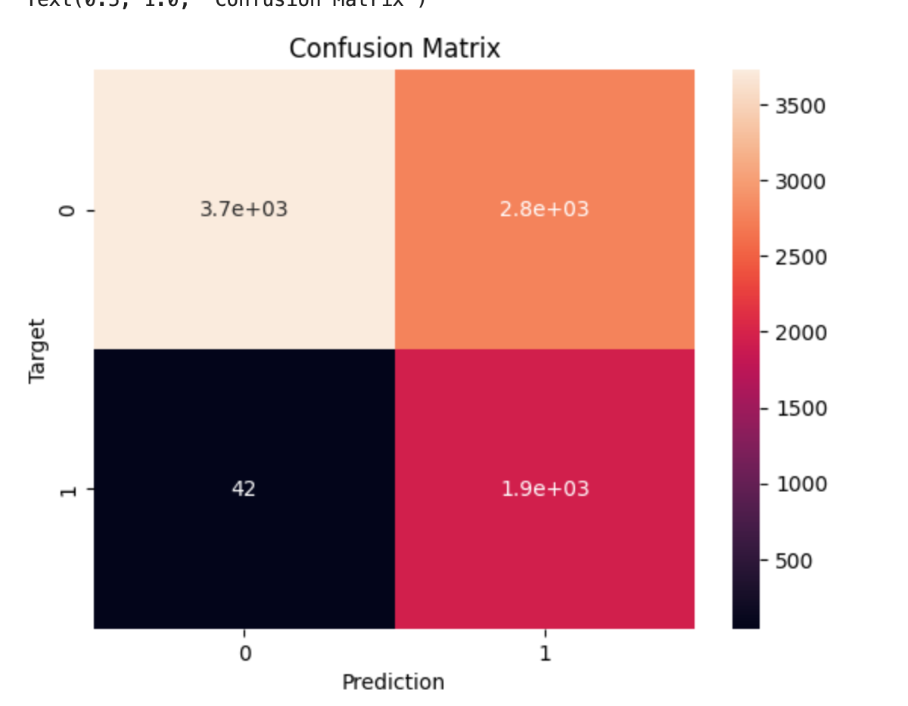
GAUSSIAN NAIIVE BAYES
Bayes classification is valued for its simplicity and efficiency, particularly in handling large datasets.
We ran GNB to identify the minimum level of performance that a simplistic model such as GNB can give us .
Also our dataset was large enough so it’s initial usage was justified.
We wrote our own version of GNB in python and didn’t use inbuilt libraries.
We wrote the code for GNB ,with alpha being our hyper- parameter,where alpha parameter in Gaussian Naive Bayes serves as a smoothing factor to prevent zero probabilities and enhance the robustness of the model.

Slide 20
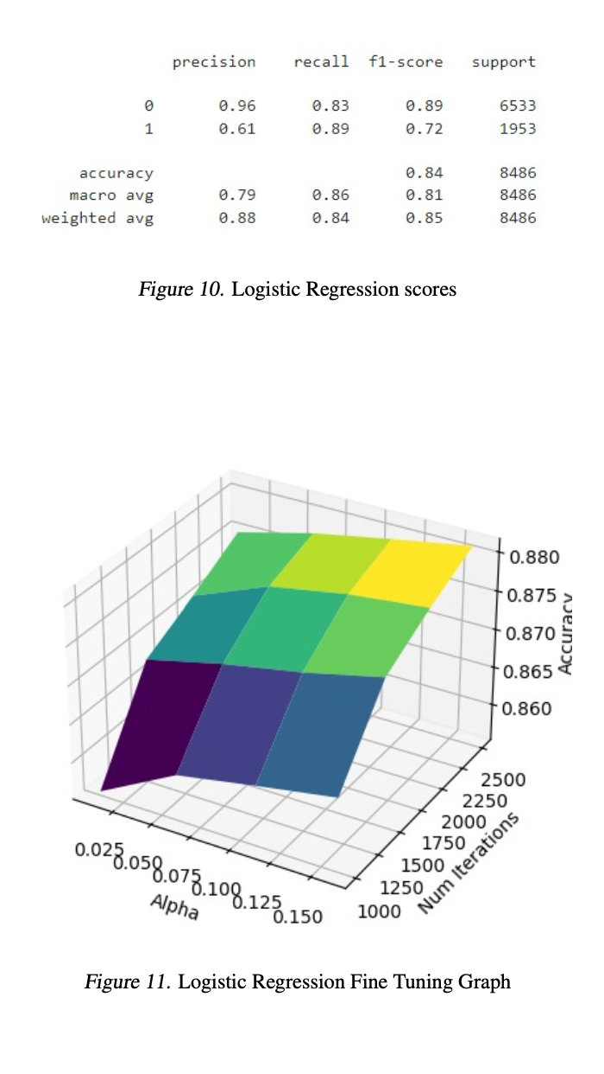
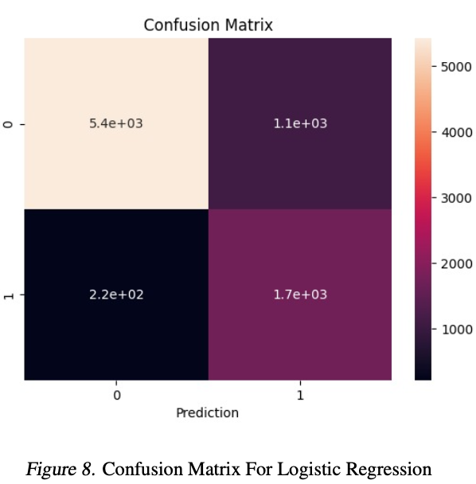
LOGISTIC REGRESSION
Thereafter we proceeded to GNB,to further improve the performance of our model
We wrote the code for logisitic regression ,with epochs and learning rate being the hyper parameters.Thereafter we proceeded to plotting the val set accuracy against learning rate.
Based on our observations, we've noticed that for alpha values exceeding approximately 0.3, the optimization process tends to overshoot, leading to NaN values for the cost function after some iterations. This behavior is attributed to the use of large alpha values. Consequently, when performing grid search, we've opted to use alpha values lower than this threshold to avoid instability and numerical issues during optimization.Then for the aformentioned values, we got the results as depicted herein this slide.
Thereafter in the range of learning_rate from 0.025 to 0.150 and in number_of_iterations from 1000 to 2500,we got the highest accuracy on val set for alpha=0.16,iterations=2500 using grid search.
weighted average F1 score : 85%

Slide 21
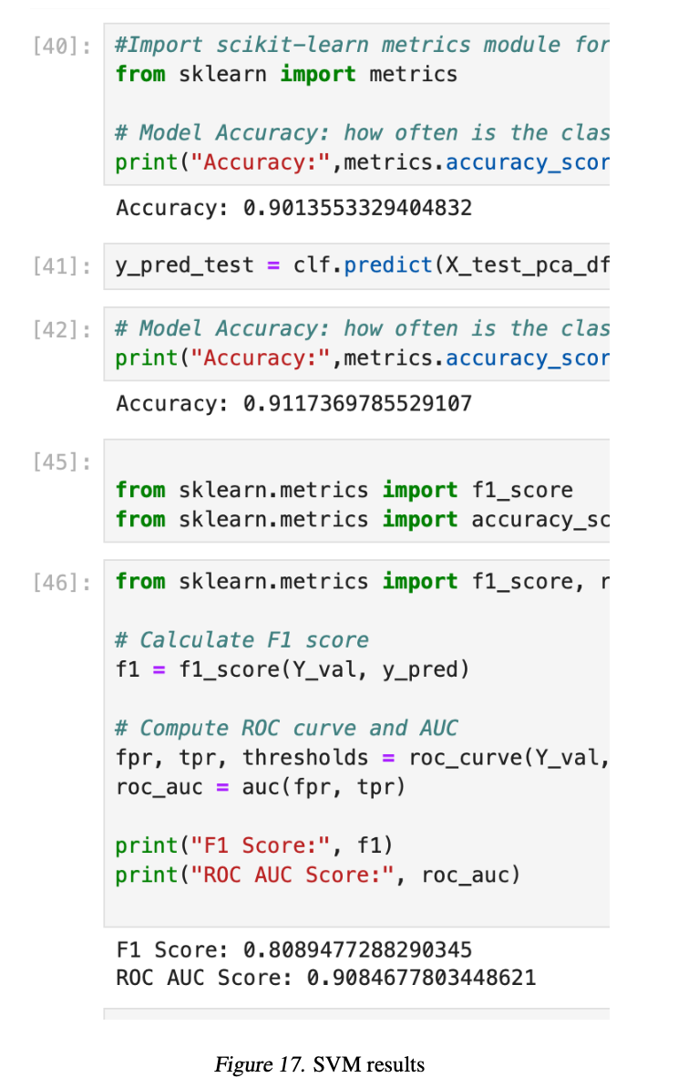
SUPPORT VECTOR MACHINE
Now we proceeded to model using SVM.
We tried building our own custom model and then tuning it ,however because of the sheer size of our data and the algorithm being O(n^3*len(parameter_list))) ,we were unable to run it for all hyperparameters to tune it so we had to resort to using sklearn.
Even after using sklearn we were unable to tune it,even for one datapoint we took 2 hours to run one case.
The results appended here are for linear kernel and keeping the alpha(cost parameter) default as whatever the sklearn has put while running,it took 25 min to fit our train data.

Slide 22
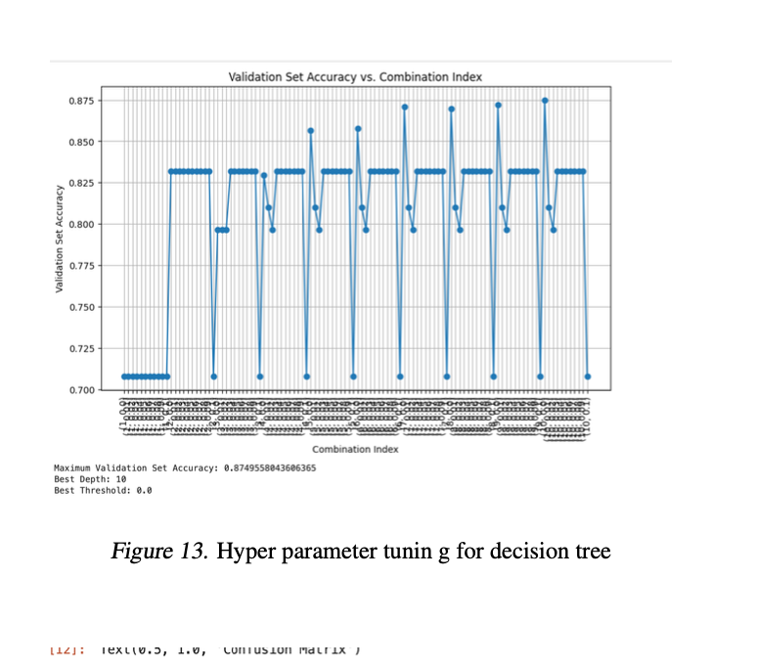
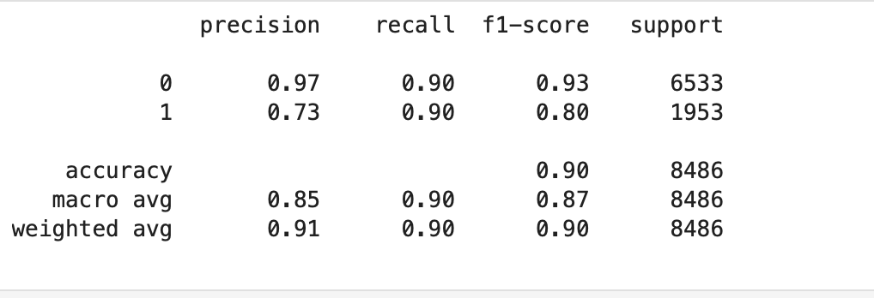
DECISION TREE
We initially tried running our custom algorithm in python ,with tree depth and threshold entropy as hyper parameters and tried to run the algorithm.
However due to the sheer size of our data ,we were not able to go beyond running just one model for a tree depth of 5 and threshold of 0.05 for which we got a val set accuracy of 77%
Hence we proceeded to use sklearn and then performed hyperparameter tuning on the said parameters.
We achieved the highest val set accuracy for depth 9 and threshold split as 0.00
We achieved a weighted average F1 Score of 0.90

Slide 23
RESULTS SO FAR
The best performance obtained was on Decision Tree with a weighted average F1 Score of 90%
After this we proceeded to compare this with Ensemble Methods
We used 200 estimators and left all the other hyperparameters in both Random Forest and Gradient Boosting set to their default as set in the sklearn library
Random Forest:
Ensemble learning method based on decision trees.
Constructs multiple decision trees during training.
Each tree is trained on a random subset of the training data and a random subset of features.
Final prediction is made by averaging or voting the predictions of individual trees.
Helps reduce overfitting and improve generalization.
Gradient Boosting:
Ensemble learning method that builds trees sequentially.
Each tree corrects the errors made by the previous one.
Trees are fitted to the residuals of the previous trees.
Typically uses shallow trees (weak learners) as base estimators.
Effective in capturing complex relationships and achieving high predictive accuracy.

Slide 24
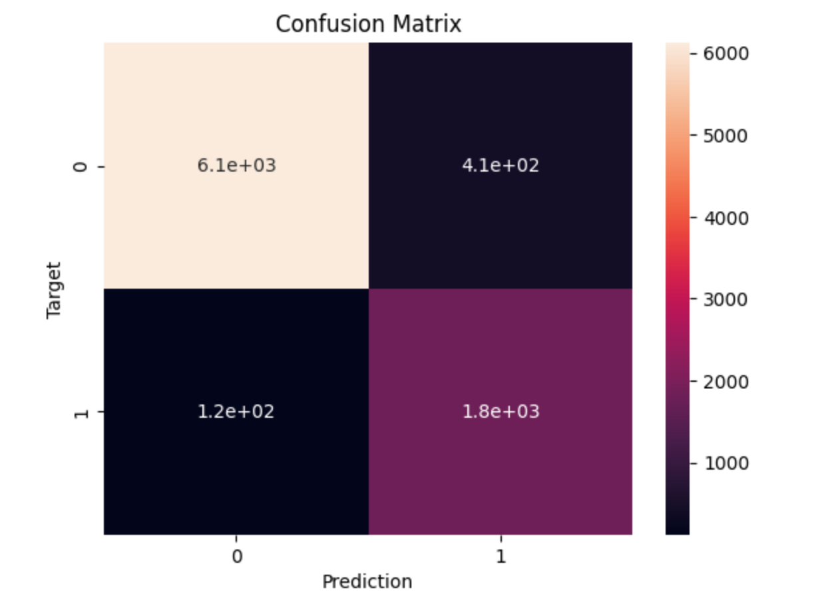
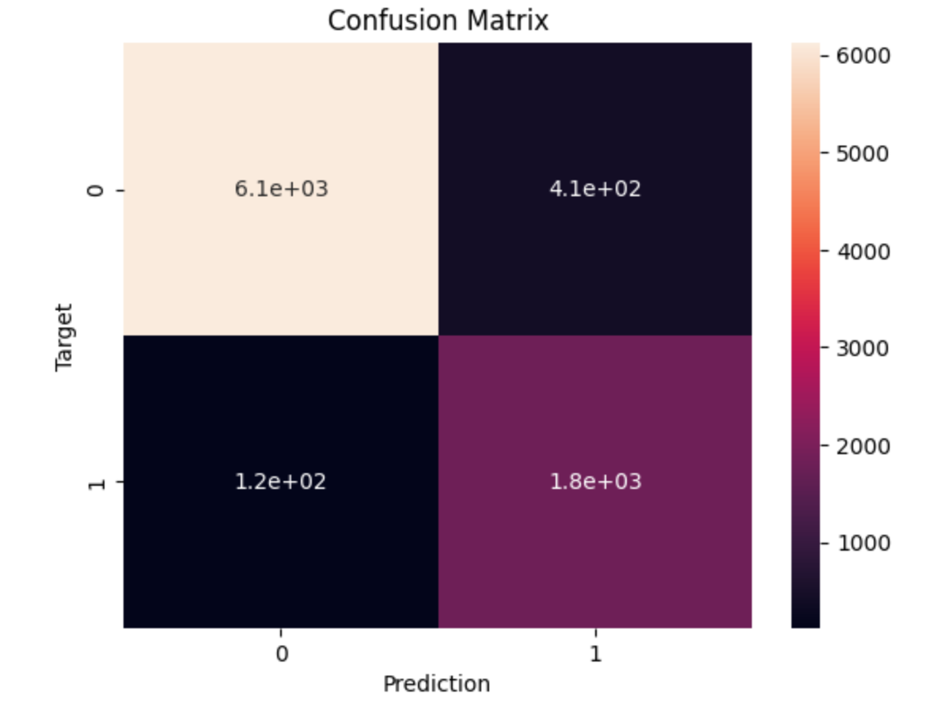
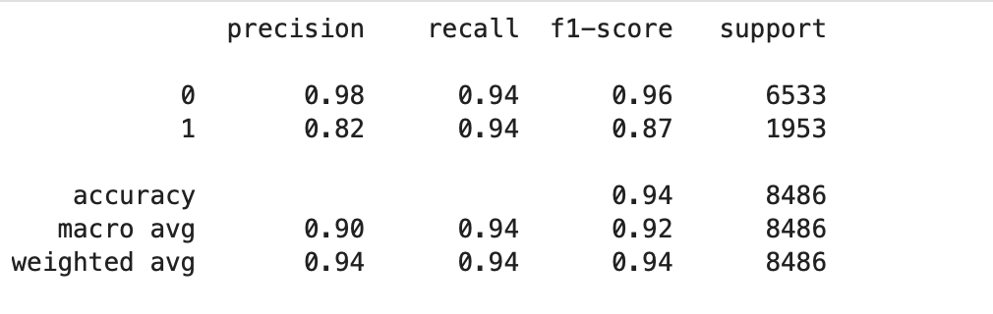
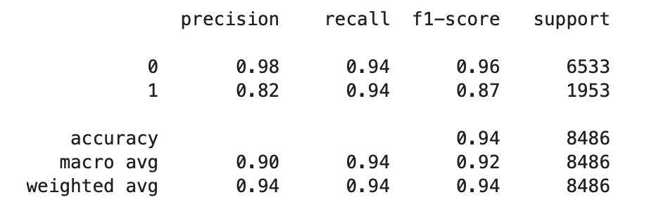
ENSEMBLE METHODS
Random Forest
Gradient Boosting

Slide 25
CONCLUSION
The F1 Score obtained on our tuned Decision Tree model was 0.90 against an F1 score of 0.94 for both the ensemble methods.

Slide 26
Thank you
Group 4

